Slide 1


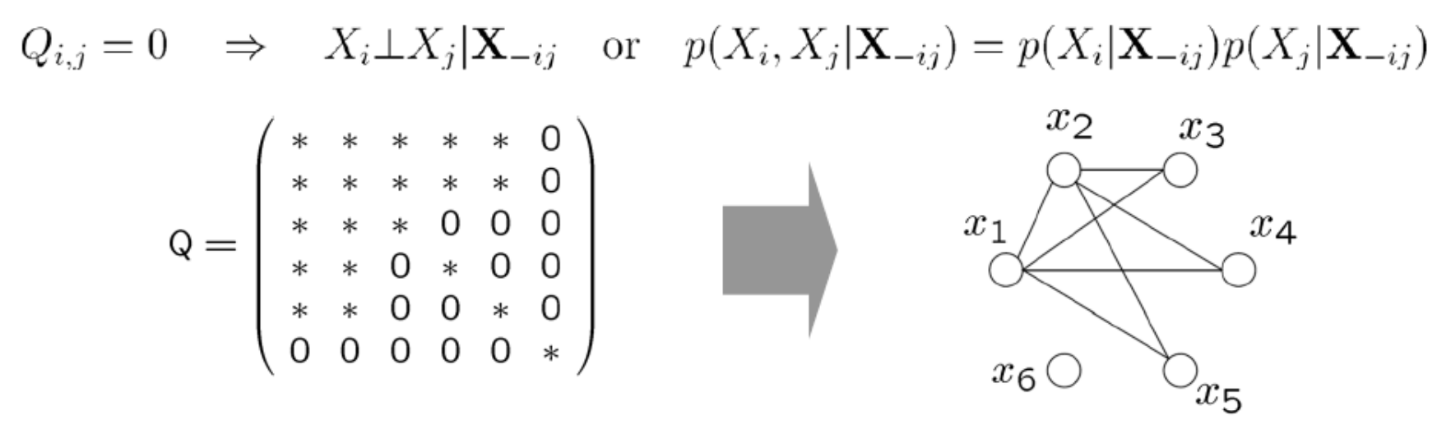
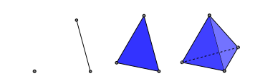

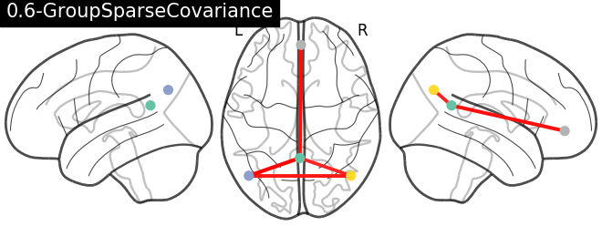
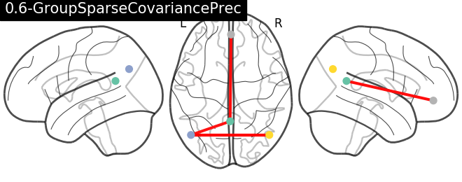
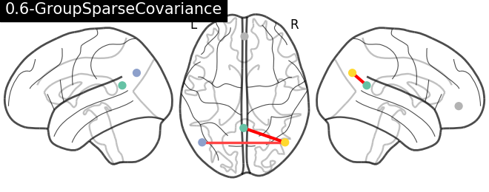
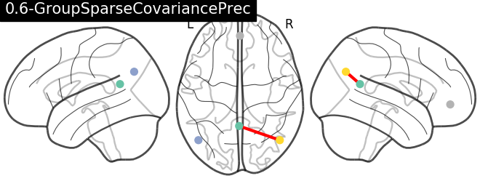
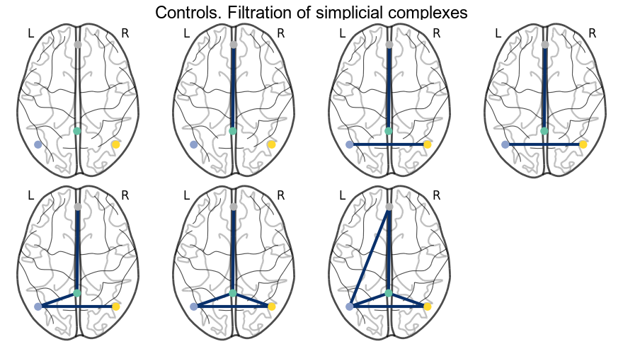
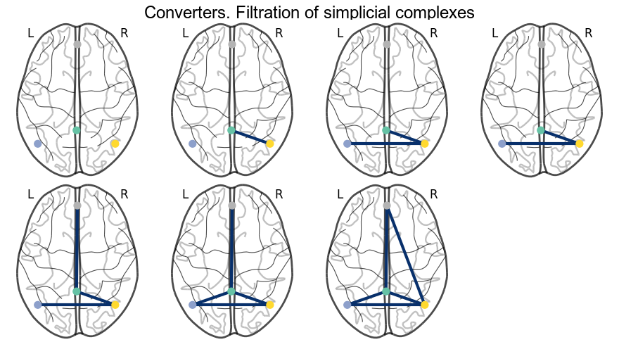
Persistent homology: a computational topology-based approach to study brain connectivity .
Jaime Gómez-Ramirez*⁺ and Bryan Strange*⁺
*Fundación CIEN, Department of Neuroimaging,Valderrebollo, 5, Madrid ⁺Universidad Politécnica de Madrid, Centro de Tecnología Biomédica, Madrid
Abstract
Contact author: jgomez@fundacioncien.es
A mechanistic understanding of brain function and malfunction requires a causal theory of the brain. Candidates for global brain theories are not missing e.g. Friston’s Free Energy minimization [12], von Malsburg’s correlation theory [2], Abeles cortinomics [3] Llinás thalamo-cortical loop [4], Tononi’s integrated information theory [5] etc. but the jury is still out on a causal explanation of cognition. Neuroimaging reveals only correlations. Causality can only be investigated through intervention, that is, stimulation or lesion. This poses a tremendous challenge in a nonlinear highly coupled system like the brain. Intervention in one area of the brain can ripple to other parts in very complex and unpredictable ways. In this work we make the argument that network models fall short of producing mechanistic models of normal function and disease.
Graphs are built by connecting one pair of elements at a time. The limitation of having exclusively dyadic (or bivariate in statistics jargon) relationships is a crucial limitation that is often overlooked [6]. Computational topology allows us to go beyond pairwise connections within an elegant mathematical framework. In particular, the connectomics of the mammalian brain can be studied with persistent homology. Persistent homology is a method of computational topology that studies the persistent structure in data sets. This framework provides a compact encoding of multi-scale relations and is agnostic to the way the coupling is computed (power-based, phase-based, Granger causality, dynamic time warping etc.). We will show using resting state fMRI connectivity data that persistent homology provides new views to understand the interplay between strong and weak connections in the brain connectome.
Introduction
Methods
Functional connectivity (FC) refers to the correlated activity between segregated neuronal populations. FC produces a network representation of the dependence between the signal of different brain areas and is typically measured using fMRI, EEG and MEG.
Covariance is the most common measure in time domain. In frequency domain, connectivity can be studied using coherence to quantify phase-synchrony between pairs of signals. These measures, however, are correlational and do not distinguish between direct and indirect effects (Boxes 1 and 2). The inverse covariance or precision matrix refers to partial correlations. Importantly, the precision matrix can be used to determine conditional independence provided that data are Gaussian. Thus, A is “connected” to B if they are correlated and the influence of other variables is regressed out.
Limitations of the network-based approach
The standard approach in network analysis consists in deriving a network from the covariance/variance matrix by establishing a threshold of convenience. There are 2 problems:
Threshold selection problem. It is not only possible but also preferable to study the relationship between nodes as the threshold changes, rather than imposing one threshold ad-hoc.
Pairwise relationships: Networks assume a simplifying assumption: the unit of interest is the dyad (two nodes)
Persistent homology uses simplicial complex -a generalization of graph- to overcome these limitations (Box 3).
We study the functional connectivity patterns of the Default Mode Network (DMN) in two groups of 23 subjects each –controls and converters to MCI in one year time. Controls and converters were matched with exact matching for gender and APOE 4 allele and propensity score for age, number of educational stages and MMSE score.
Preprocessing
The fMRI signal was preprocessed (slice-timing, head motion, normalization MNI152 coordinate space, spatial filtering (FWHM=8mm) and temporal filtering (band pass 0.01-0.2 Hz). The time series were centered ~N(0,1) and detrended to eliminate the drift. The time series for the DMN nodes were extracted using nilearn.NiftiSpheresMasker with the radius for the sphere around the seed set to 8mm.
Connectivity measures
We estimated the empirical covariance matrix and the sparse inverse covariance matrix using the graph lasso algorithm. The graph lasso estimator (Box 2) uses a penalty in order to induce sparsity in the precision matrix. If the coefficient in the precision matrix is 0 then the two variables are conditionally independent given the observations of the other variables, graphically, there is no edge connecting the nodes (Box 1). The precision matrix defines the adjacency matrix of the Markov Random Field dependency network.
Persistent homology
We approach the threshold selection problem using a multi-scale network framework to compute simplicial complexes (Box 3). A filtration of a simplicial complex is a nested sequences starting with the DMN complex (disconnected nodes) and ending with a connected simplicial complex.
Box 1. Precision matrix distinguishes between direct(*) and indirect(0) effects
where K is the precision matrix to be estimated, S is the empirical covariance matrix and ||K|| is the sum of the absolute values of the off-diagonal elements or L1 norm.
Box 2. Sparse inverse covariance estimation
A graph is a set of vertices and a set of edges, G(N,E). A simplicial complex, K(N,S), on the other hand, is a set of vertices and a collection of simplices where a simplex is a finite set of vertices with the additional property that any subset of a simplex is also a simplex.
Given a simplicial complex K, a filtration is a succession of growing subcomplexes
Persistent homology is a method used in topological data analysis to study qualitative feature of data that persist across multiple scales.
From left to right a 0-simplex, 1-simplex, 2-simplex, 3-simplex and 3 1-simplices. Note that the network on the right does not form a 2-simplex.
Results
Box 3. The simplicial complex is a high dimensional structure that generalizes
network. Persistent homology is a method for computing topological features
at different dimensional scales or space resolutions.
Figure 1 shows the results for group level analysis of the covariance and the precision
matrices for both groups using a threshold, .The DMN nodes in MNI space are:
Posterior Cingulate Cortex (0, -52, 18), Left Temporoparietal junction (-46, -68, 32),
Right Temporoparietal junction (46, -68, 32) and Medial Prefrontal Cortex (1, 50, -5).
The connection between the mPFC and the PCC found in the control group in both
covariance and precision matrices is not present in the converter group.
Now, rather than using one threshold, we define the n dimensional array of thresholds to obtain one network for each threshold. Using algebraic topology we can study the filtration of a simplicial complex as a nested sequence of subcomplexes (Figure 2). The filtration starts with 4 0-simplices (the DMN) and in the successive filtration steps, higher dimensional simplices appear. The persistence of homology classes of a filtration of simplicial complexes can be visualized with barcodes (Figure 3).
Controls
Converters | Covariance based connectivity | Precision (Sparse Inverse Covariance) based connectivity
Figure 3. Barcode for the filtration showing the persistence of the 1-simplex PCC-mPFC. In the control group this 1-simplex is created in step 1 and persists while in the converters is created as late as step 4 and it also persists.
Figure 1. DMN connectivity for covariance matrix and precision matrix (conditional independence). The
mPFC and the PCC are only “connected” in the control group.
Figure 2. Filtration of simplicial complexes
Conclusions
Arguably, causality is nowhere more elusive than in neuroscience. A causal model needs to encode invariance.
Using persistent homology we find that the 1-simplex mPFC-PCC is more persistent in the control group than in the converter group.
References
[1] K. Friston. The free-energy principle: a unified brain theory? Nature Reviews Neuroscience, 11(2):127138, 2010.
[2] C. Von Der Malsburg. The correlation theory of brain function. In Models of neural networks, Springer, 1994.
[3] M. Abeles. Corticonics: Neural Circuits of the Cerebral Cortex. Cambridge University Press, 1991.
[4] R. Llinás and U. Ribary. Coherent 40Hz oscillation characterizes dream state in humans PNAS, 90(5):20782081, 1993.
[5] W. Marshall, J. Gomez-Ramirez, and G. Tononi. Integrated information and state differentiation. Frontiers in Psychology, 7, 2016.
[6] C. Giusti, R. Ghrist, and D. S. Bassett. Two’s company, three (or more) is a simplex: Algebraic-topological tools for understanding higher-order structure in neural data. arXiv preprint arXiv:1601.01704, 2016.
Notes:
Conclusions: The goal is not to obtain an all-encompassing theory (or
at least not at first!)
Complex systems needs of multiple views. We need to
enrich the theoretical context in neuroscience
Creative act: not just to apply existing theories but the
ability to create new theories that structurally match
(category theory, group theory)
To equate theoretical neuroscience with computations is
due to the wrong assumption that the principles are
already known.
The main task in to discover those fundamental principles
or laws (habits)
sklearn.covariance package does the estimation of a population’s covariance matrix. empirical covariance:
References
[1] M. Abeles. Corticonics: Neural Circuits of the Cerebral Cortex. Cambridge University Press, 1991.
[2] K. Friston. The free-energy principle: a unified brain theory? Nature Reviews Neuroscience, 11(2):127138, 2010.
[3] C. Giusti, R. Ghrist, and D. S. Bassett. Two’s company, three (or more) is a simplex: Algebraic-topological tools for understanding higher-order struc- ture in neural data. arXiv preprint arXiv:1601.01704, 2016.
[4] R. Llinás and U. Ribary. Coherent 40- hz oscillation characterizes dream state in humans. Proc Natl Acad Sci U S A., 90(5):20782081, 1993.
[5] W. Marshall, J. Gomez-Ramirez, and G. Tononi. Integrated information and state differentiation. Frontiers in Psy- chology, 7, 2016.
[6] C. Von Der Malsburg. The correlation theory of brain function. In Models of neural networks, pages 95119. Springer, 1994.
There is no privileged scale of causality in biology. Causality is nowhere more elusive than in neuroscience. This is because the brain does it all, self organized criticality, low dimensional chaos, predictive coding etc.
A causal model is a symbolic system that encodes the invariance, what remains constant.Conditioning probabilities do not work for intervention
One trended time series regressed against another will often reveal a strong, but spurious, relationship. Put another way, we’ve introduced a mutual dependency. By introducing a trend, we’ve made X correlated with Y but this is because they have a common cause Z (trend).
correlation is not causation and there is not correlation without causation: If A corr B and neither A causes B or B causes Athen there must be some common cause of the two, somewhere upstream there is a common cause. We need to control for common causes if you trying to estimate causal effects because when there is a common cause between two variables,then they will be correlated.
Functional connectivity is at its root a covariance selection problem
Count number of simplices:
Prec
1 simplex: Control 22-22
2 simplex: 5-5
3-simplex 0-0
Cov
1-simplex: 22-22
2-simplex: 5-6
Prec
How many 2 simplices the PCC belongs to
5-5
The MPFC
2-2
1-simplex 9-6
Cov
PCC 2s 5-6
1s 16-14
MPFC 2simplex: 2-2
1-simplex 8-5

